Slide 1
Files in C

Slide 2
What is a File?
A file is a collection of related data that a computer treats as a single unit.
Computers store files to secondary
storage (HD, FD) so that the contents
of files remain intact when a computer shuts down.
When a computer writes to a file, it
transfers data from memory to the
storage device; when it reads a file, it
copies the file from the storage device to memory.

Slide 3
Steps in Processing a File
Open the file, associate it with the file name.
Read or write the data.
Close the file.
Thanks to C, we have library functions to perform all of the above tasks, you just need to know what are those…..

Slide 4
Writing to a File
Open the file, associate it with the file name.
Read or write the data.
Close the file.
#include <stdio.h> void main(){
FILE *fp;
fp = fopen(“data.txt”,”w”);
if(fp == NULL){
printf(“Error….”); return;
}
}
A structure called FILE
(defined in stdio.h) is
used to store the attributes of a file.
Error can happen for the following reasons:
--There is no space
--Wrong drive
--Do not permission etc etc….
have write

Slide 5
Writing to a File
Open the file, associate it with the file name.
Read or write the data.
Close the file.
#include <stdio.h> void main(){
FILE *fp;
fp = fopen(“data.txt”,”w”); if(fp == NULL){
printf(“Error….”); return;
}
int a = 76; float f = 9.8; char c = ‘Z’;
fprintf( fp, “%d %f %c”, a, f, c);
}

Slide 6
Writing to a File
Open the file, associate it with the file name.
Read or write the data.
Close the file.
#include <stdio.h> void main(){
FILE *fp;
fp = fopen(“data.txt”,”w”); if(fp == NULL){
printf(“Error….”); return;
}
int a = 76; float f = 9.8; char c = ‘Z’;
fprintf(fp, “%d %f %c”, a, f, c); fclose(fp);
}

Slide 7
Reading from a File
Open the file, associating it with the file name.
Read or write the data.
Close the file.
#include <stdio.h> void main(){
FILE *fp;
fp = fopen(“data.txt”,”r”); if(fp == NULL){
printf(“Error….”); return;
}
}
A structure called FILE
(defined in stdio.h) is
used to store the attributes of a file.
Error can happen for the following reasons:
--The ile does not exist
--Wrong drive etc etc….

Slide 8
Reading from a File
Open the file, associating it with the file name.
Read or write the data.
Close the file.
#include <stdio.h> void main(){
FILE *fp;
fp = fopen(“data.txt”,”r”); if(fp == NULL){
printf(“Error….”); return;
}
int a; float f; char c;
fscanf( fp,“%d %f %c”, &a, &f, &c);
printf(“%d %f %c”, a, f, c);
}

Slide 9
Reading from a File
Open the file, associating it with the file name.
Read or write the data.
Close the file. #include <stdio.h> void main(){
FILE *fp;
fp = fopen(“data.txt”,”r”); if(fp == NULL){
printf(“Error….”); return;
}
int a; float f; char c;
fscanf(fp, “%d %f %c”, &a, &f, &c);
printf(“%d %f %c”, a, f, c); fclose(fp);

Slide 10
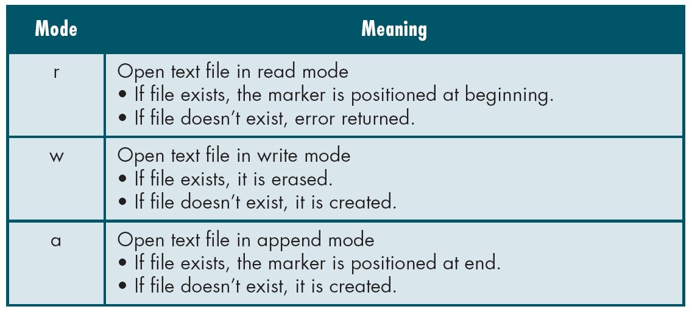
File Open Modes

Slide 11
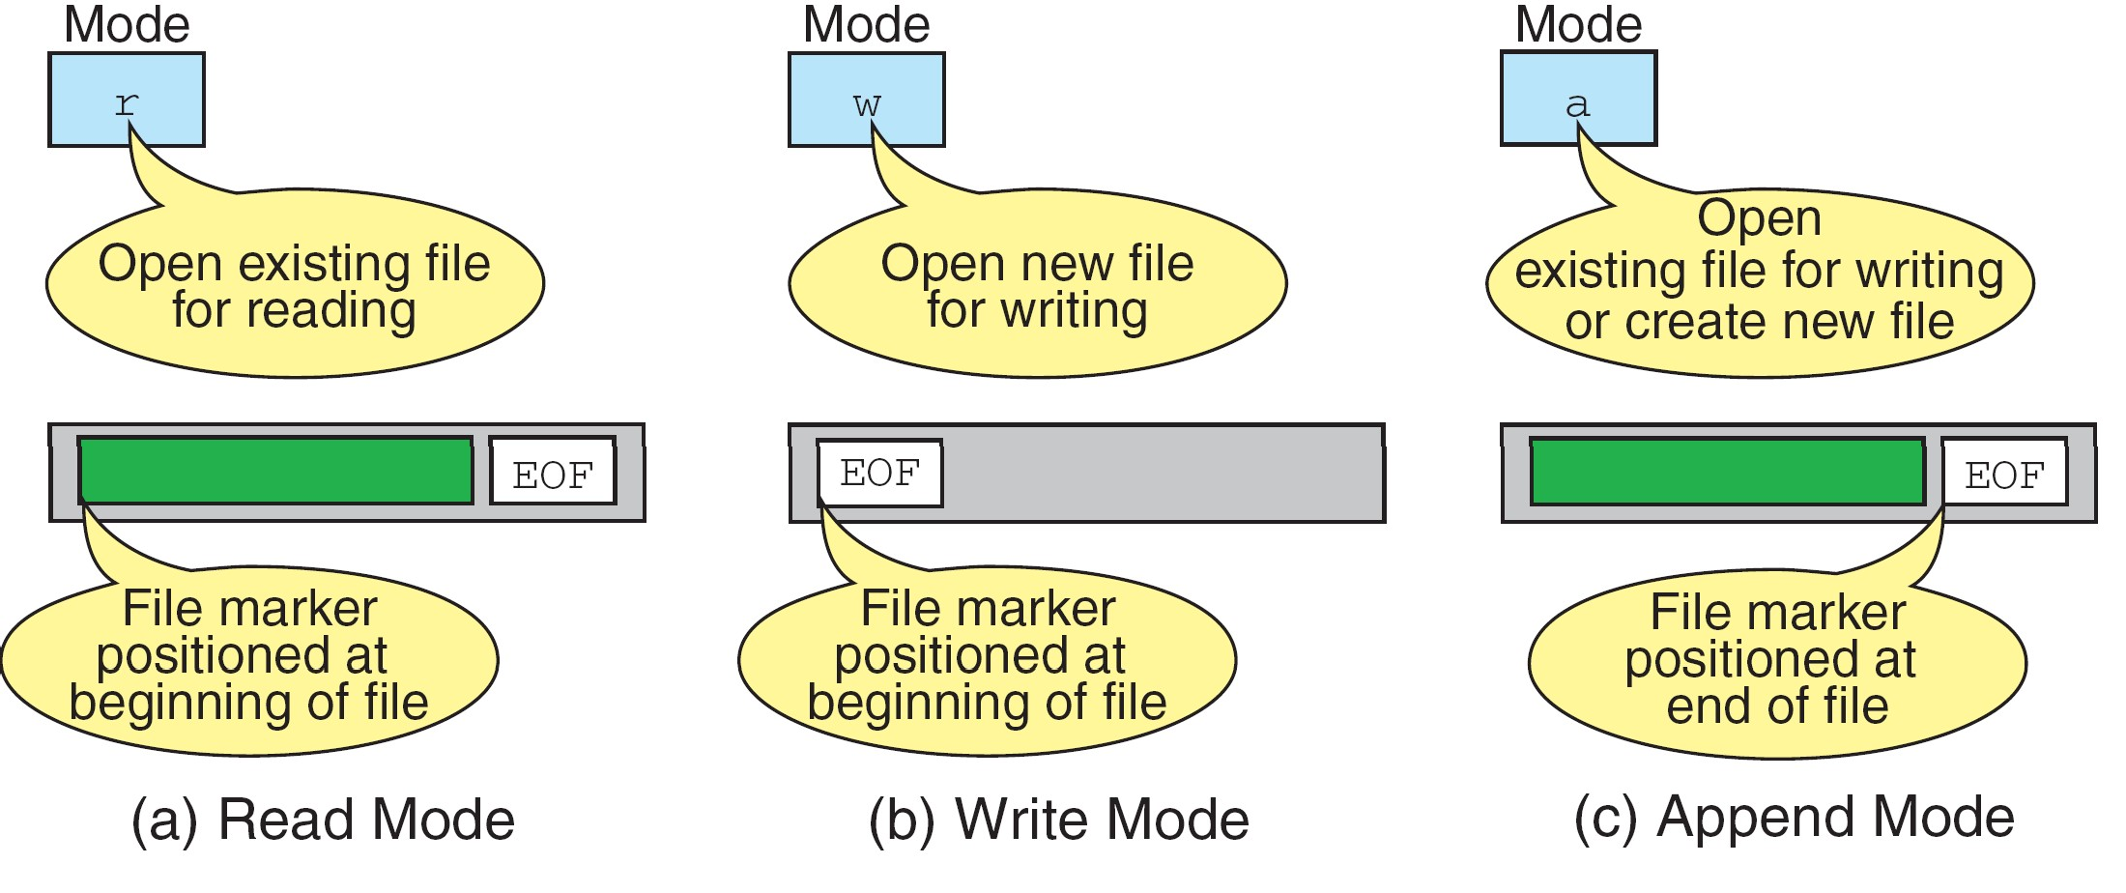
More on File Open Modes

Slide 12
Additionally,
“r+” open for reading and writing, start at beginning
“w+” open for reading and writing (overwrite file)
“a+” open for reading and writing (append if file exists)

Slide 13
fgetc()
Syntax:
identifier = fgetc (file pointer); Example:
FILE *fp; fp=fopen(“input.txt”,”r”); char ch;
ch = fgetc (fp); printf(“%c”,ch);
fclose(fp);

Slide 14
fputc()
Write a single character to the output file, pointed to by fp.
Example:
FILE *fp; char ch = ‘A’;
fp=fopen(“input.txt”,”w”); fputc (ch, fp);
fclose(fp);

Slide 15
Question
Write down a program that will copy one file to another file. Both file names will be input to your program.

Slide 16
The Program
#include <stdio.h> void main(){
FILE *fp1,*fp2;
char s[80],t[80],ch; gets(s);
gets(t);
fp1 = fopen(s,”r”);
fp2 = fopen(t,”w”);
if(fp1 == NULL || fp2 == NULL){ printf(“Error….”); return;
}
while(1==1){
ch = fgetc(fp1); if(ch == EOF) break; fputc(ch,fp2);
}
fclose(fp1); fclose(fp2);
}
Files
18

